Slide 1

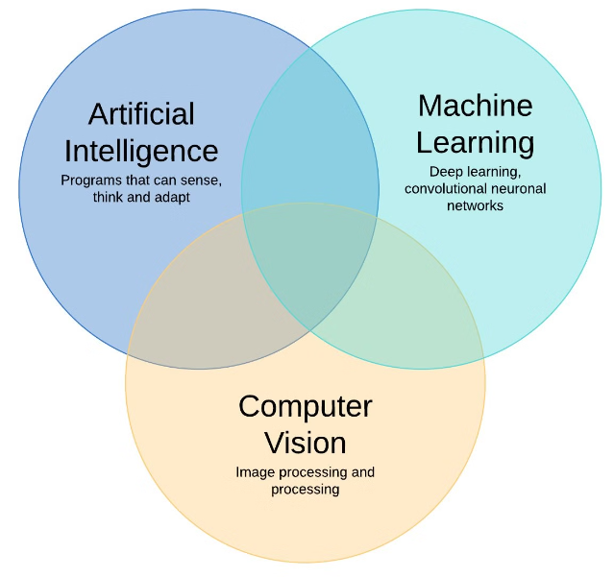
Real-Time Object Detection and Segmentation using YOLO and OpenCV
This project implements real-time object detection and segmentation using the YOLO (You Only Look Once) model and OpenCV for video processing. The goal is to identify and segment objects in a video stream, providing bounding boxes and segmentation masks. The technologies used include YOLO, OpenCV, cvzone, and Python.

Slide 2
Objectives
Real-Time Detection
Accuracy
Segmentation
Achieve real-time object detection and segmentation on video streams, ensuring the system can process frames quickly enough for seamless, low-latency performance.
Utilize a pre-trained YOLO model to ensure high accuracy in object detection, enabling reliable identification of various objects in the video.
Provide segmentation masks for detected objects, allowing for detailed analysis and understanding of the spatial extent and boundaries of each identified item.

Slide 3
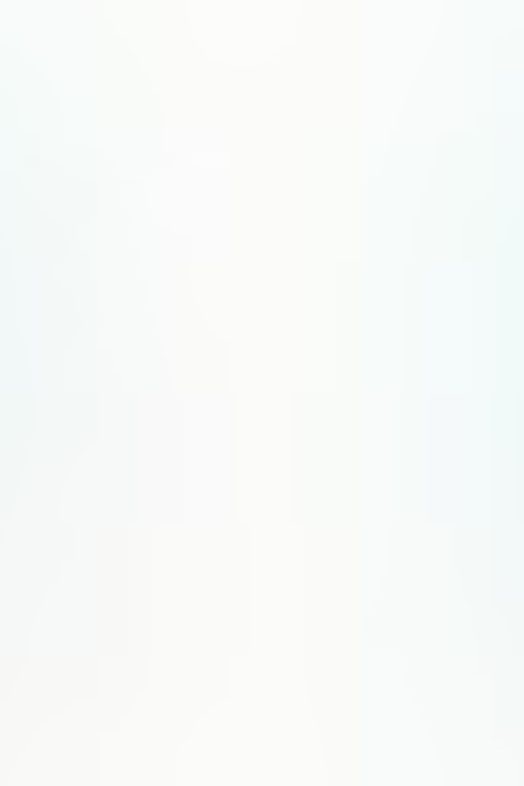
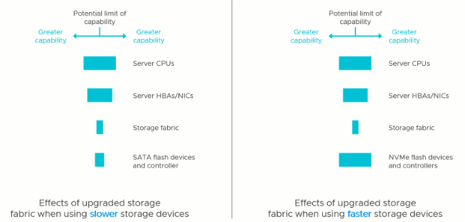
Drawbacks of Existing Systems
1
High Latency
Many existing systems suffer from high latency, making them unsuitable for real-time applications where responsiveness is crucial.
2
Limited Segmentation
Some object detection models do not support segmentation, limiting their usability in applications requiring detailed object contours and outlines.
3
Resource Intensive
High computational requirements for real-time processing can be a barrier for deployment on resource-constrained devices, such as edge computing platforms.

Slide 4

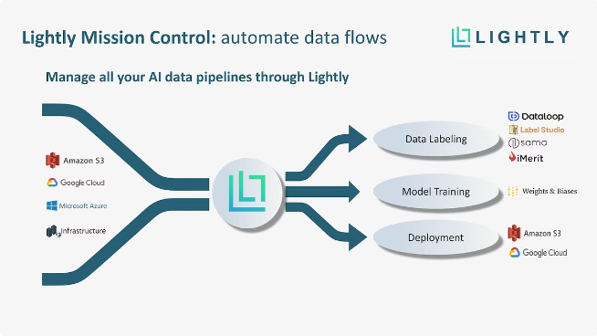
Architecture
1
Input
Video stream from a file or camera, providing the raw data for the object detection and segmentation system to process.
2
Processing
Frame extraction and resizing, object detection and segmentation using the YOLO model, and contour extraction for the segmentation masks.
3
Output
Display of the video frames with bounding boxes, segmentation contours, and class labels, providing the user with a visual representation of the detected and segmented objects.

Slide 5
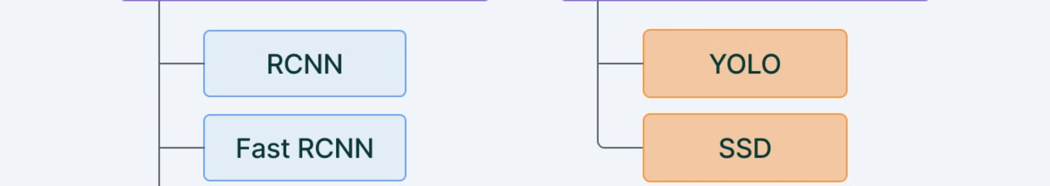




Implementation
Load YOLO Model
Read Video Stream
Frame Processing
Post-Processing
Load the pre-trained YOLO model and class names to enable object detection and classification.
Capture the video stream, either from a file or a live camera feed, to process the incoming frames.
Extract frames from the video, resize them for consistent processing, and perform object detection and segmentation using the YOLO model.
Extract bounding boxes and segmentation masks, and draw contours and labels on the processed frames for visualization.

Slide 6
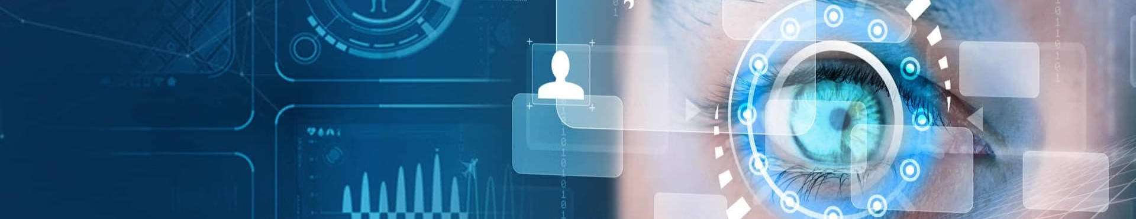
Conclusion
Achievements
Impact
Successfully implemented a real-time object detection and segmentation system using YOLO and OpenCV, capable of detecting and segmenting objects in a video stream and displaying bounding boxes, segmentation contours, and class labels.
This project demonstrates the effectiveness of using YOLO for real-time applications, providing accurate and detailed object analysis, which can be valuable in various computer vision and video analytics use cases.

Slide 7
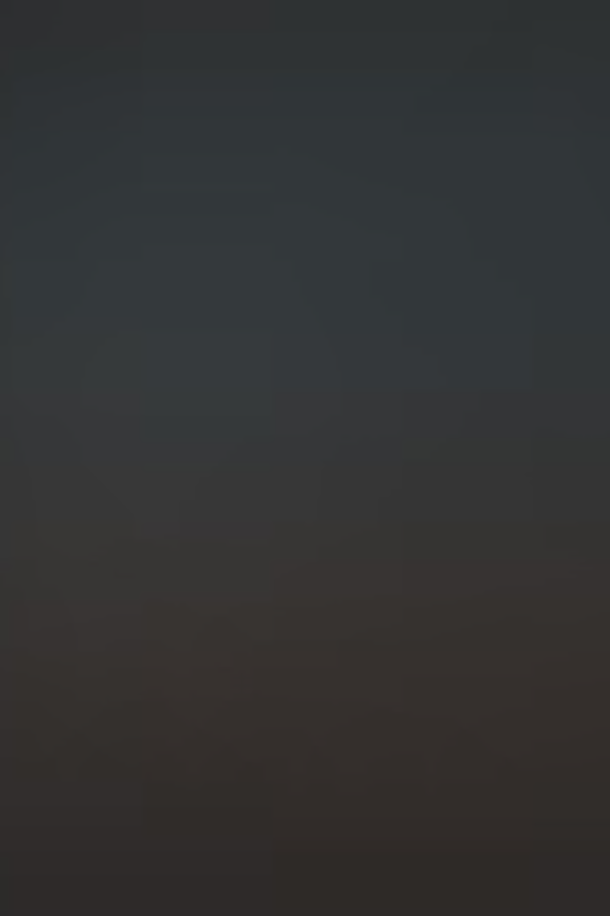
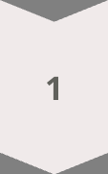
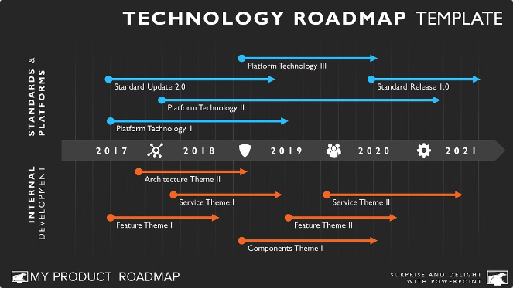


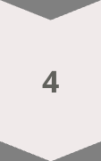
Future Enhancements
Optimization
Further optimize the code for better performance on lower-end hardware, enabling wider deployment and accessibility.
Real-Time Streaming
Integrate with live video streams from webcams or IP cameras, expanding the system's capabilities for real-time monitoring and analysis.
Advanced Visualization
Enhance the visualization with more detailed information, such as confidence scores and object tracking, to provide richer insights to users.
Multi-Model Support
Add support for multiple object detection and segmentation models to handle a wider range of objects and scenarios, improving the system's versatility.

